Slide 1
APHS 20203
Epidemiology & Biostatistics
Course Introduction and Icebreaker

Slide 2
APHS 20203
Epidemiology & Biostatistics
Objectives
1
Get aquatinted with each other
Become familiar with the syllabus
Mark important dates
Understand the assignments
2
3
Explain the use of statistics and epidemiology in health sciences
OBJECTIVES
3

Slide 3
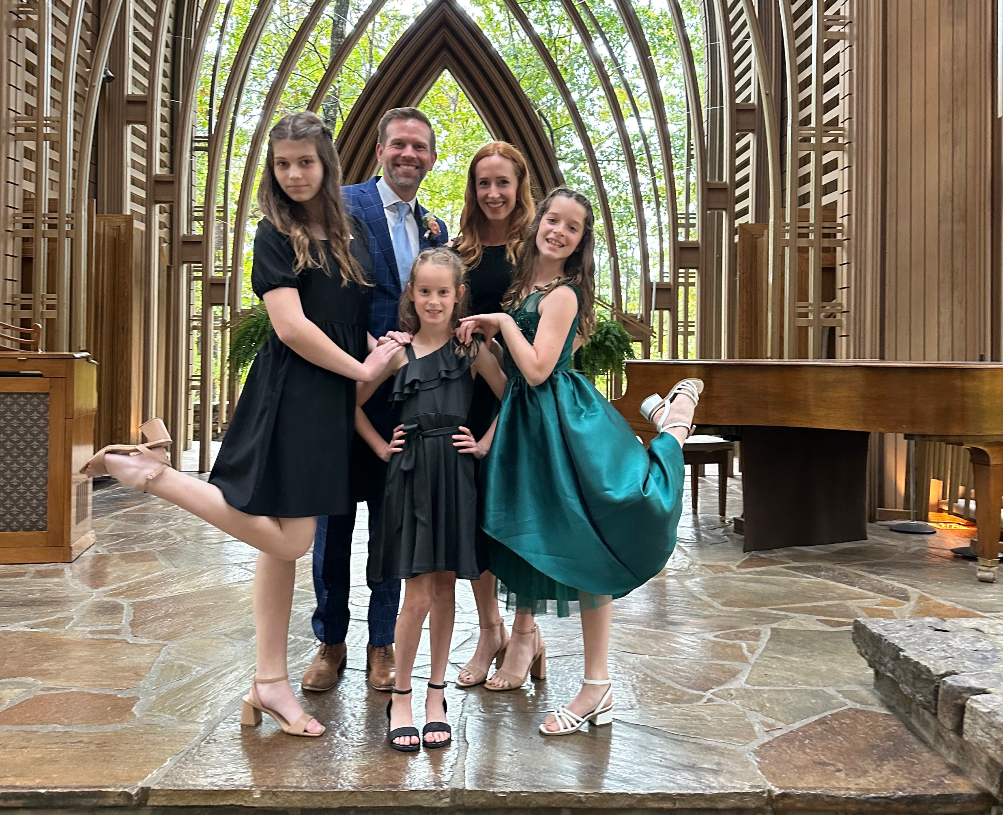
Notes:
Husband and girl dad x 3.
My wife, Tracy, is a TCU alumna.

Slide 4
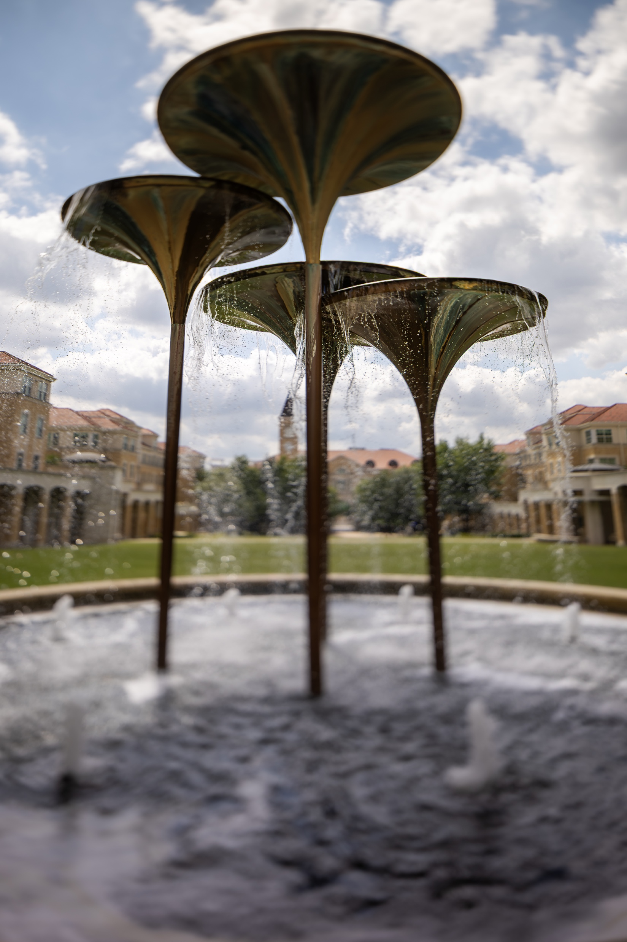
APHS 20203
Epidemiology & Biostatistics
About Me
Brad Cannell, PhD, MPH
Professor
Associate Dean for Research
Co-Director, Center for Neurodegenerative Disease
ABOUT ME
4

Slide 5
APHS 20203
Epidemiology & Biostatistics
Education
1
BA, Political Science and Marketing, University of North Texas
ABOUT ME
4
Notes:
But before that, I got my Bachelor’s degree in Political Science and Marketing from the University of North Texas. I wasn’t exactly sure what I wanted to do, but I though maybe be a lawyer.
Then 9/11 happened.

Slide 6
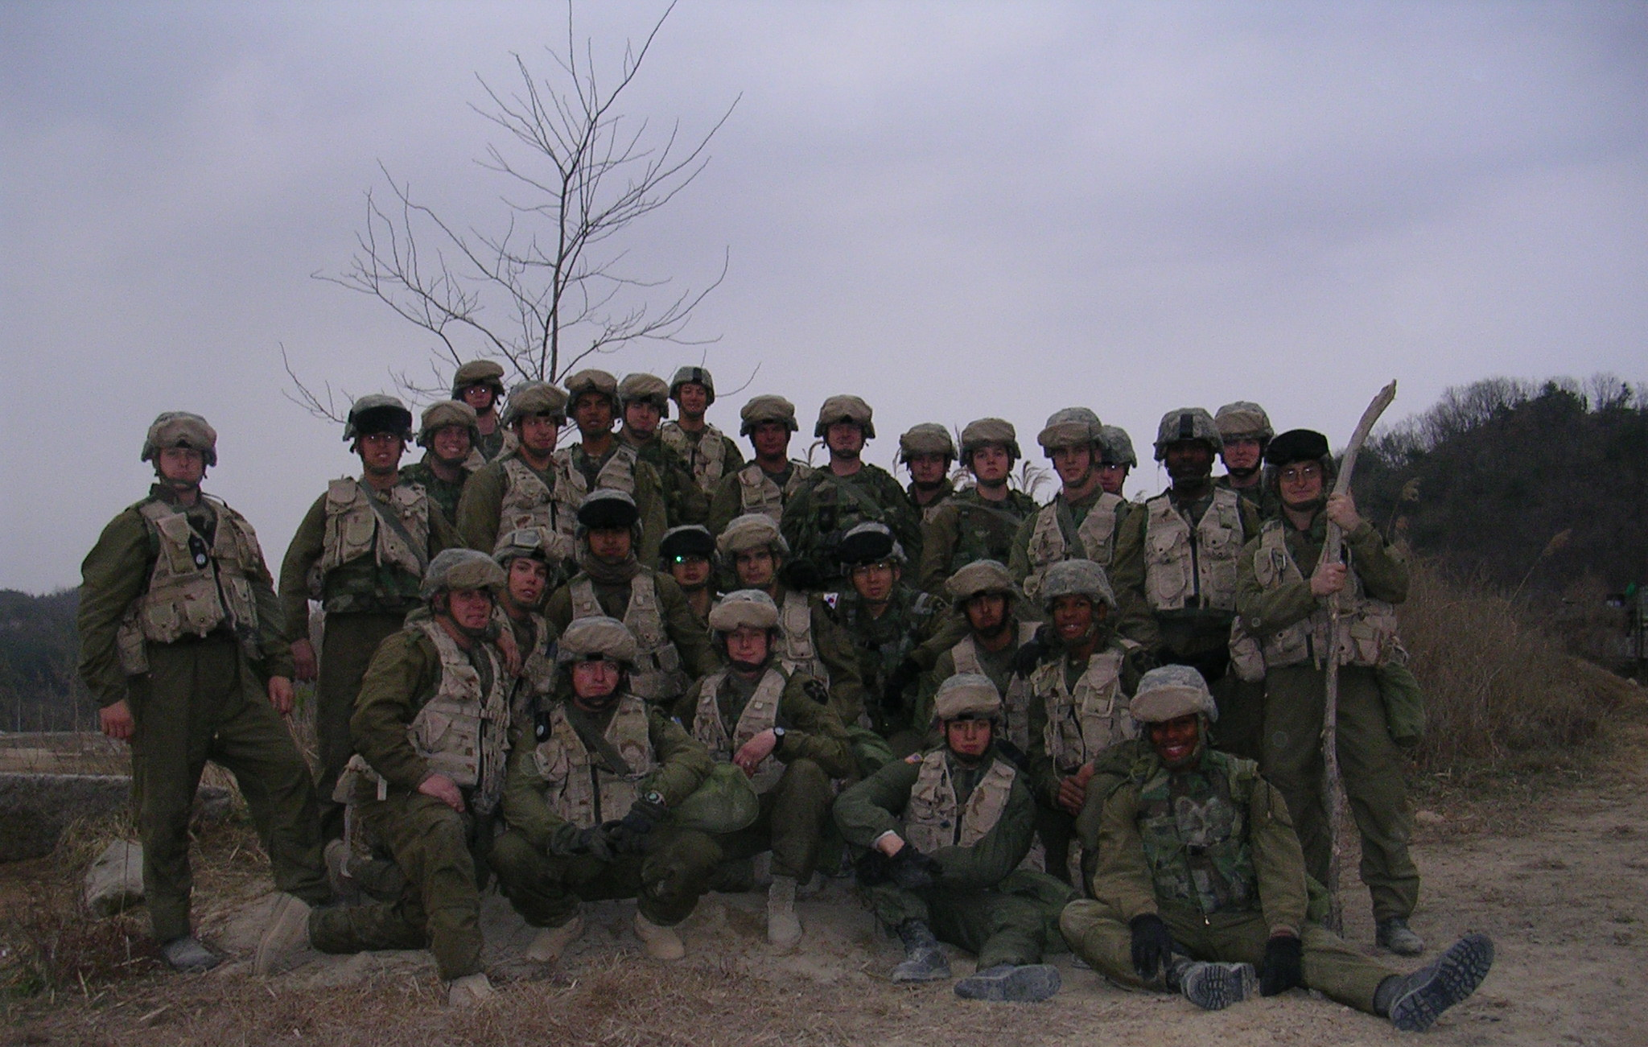
Notes:
While overseas, around the time this picture was taken, I get a message letting my know that my great grandmother died.

Slide 7
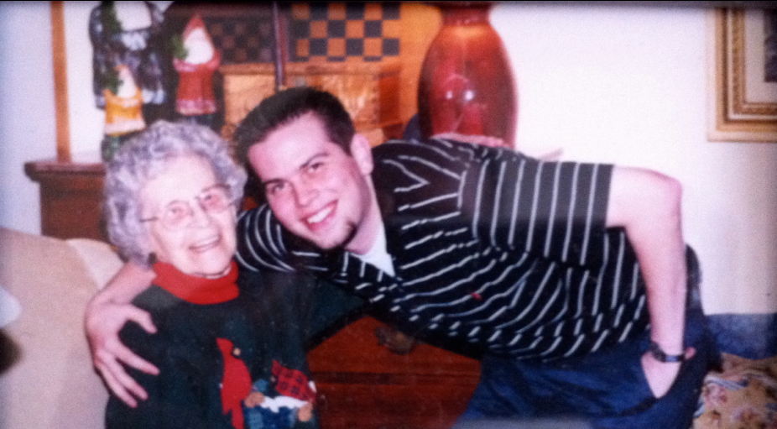
Notes:
This is my great-grandmother, Regina Smith. I spent a great deal of time with this remarkable woman while I was growing up, and we were very close.
Up until the age of 90, she took no medication except for an occasional over-the-counter pain reliever. She did calisthenics every morning, gardened, and took regular walks. She volunteered at the local hospital, was a member of a local club that took bus tours, and was an avid St. Louis Cardinals fan.
Around age 89 or 90, she developed dementia, and things began to change; once they changed, there was a very rapid decline. By the end of her life she was living in a nursing home and spent the last years of her life in exactly the way that most people do not want to spend the last years of their life – scared, confused, and seemingly alone.
I was not able to leave the country to attend her funeral, and I was devastated.
Additionally:
1. Terrified me. I never wanted to have to see anyone else go through this, or for anyone to see me go through this.
2. Confused me. How could someone who had always been so healthy take such a drastic turn for the worse? She did the “right” things but managed to spend her final years of life, and die, in what I consider to be a worst-case scenario.
Why am I telling you all of this? I’m telling you because many, many people have similar stories about their grandparents, parents, spouses, siblings, and friends, and my hope is that hearing these stories will eventually serve as a catalyst for improved health and quality of life for people aging in the United States. I’m also telling you because of the profound impact this had on my current interest in gerontology and the epidemiology of aging.
And this experience was really the inspiration for my entire career.

Slide 8
APHS 20203
Epidemiology & Biostatistics
Education
1
BA, Political Science and Marketing, University of North Texas
2
MPH, Epidemiology, University of Louisville
3
PhD, Epidemiology, University of Florida
4
Grad Cert, Predictive Analytics, University of Maryland
5
Grad Cert, Big Data and Social Analytics, MIT
ABOUT ME
4
Notes:
So, when I got back to the US, I went back to school.

Slide 9
Army NKIDHD LMHD FODH University of Florida
Aging Research Physical Function Cognitive Function Disability Elder mistreatment
2012
2014
2018
2024
Instructor Community Health UNTHSC
Theoretical Foundations Injury and violence prevention Epi of Aging Advanced Epi methods
Assistant Professor Biostatistics & Epidemiology UNTHSC
Intro to Data Management and Statistical Computing
Associate Professor EHGES UTHealth-Houston
Introduction to R Programming and Data Management Epidemiology III
TCU
HCHS 80313: Introduction to R Programming and Data Management APHS 20203: Epidemiology & Biostatistics

Slide 10
APHS 20203
Epidemiology & Biostatistics
Let’s Get to Know Each Other!
Take 30 seconds to introduce yourself.
Your Name: Create your name card (Big Font Print)
Major and minor: What are you studying?
Hometown: Where are you from?
A Fun Fact: Share one hobby, favorite food, or something unique about you.
Your Goals: What do you hope to do after graduation?
ICEBREAKER
5
Notes:
I’m finally done talking about myself. Now, I’d like to hear more about you!

Slide 11
APHS 20203
Epidemiology & Biostatistics
The Syllabus
Open the course syllabus in D2L
THE SYLLABUS
6

Slide 12
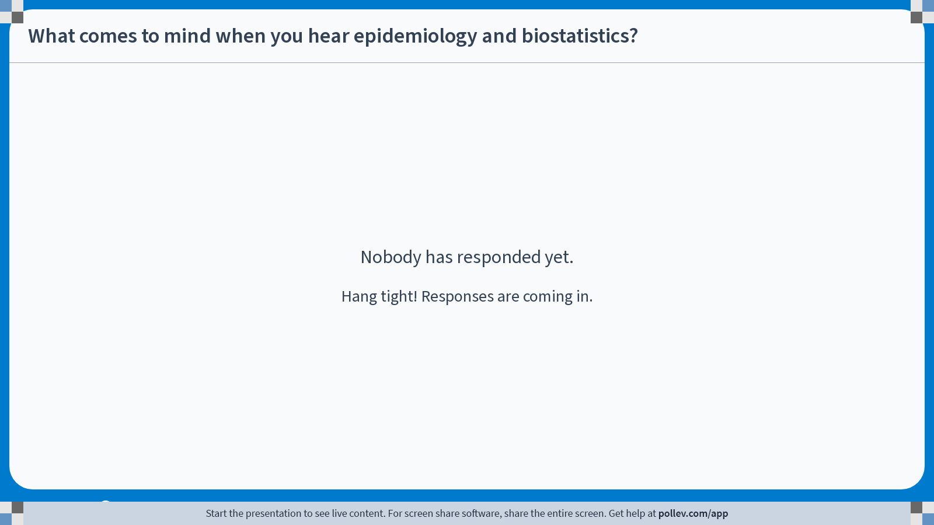
Notes:
Do not modify the notes in this section to avoid tampering with the Poll Everywhere activity. More info at polleverywhere.com/support What comes to mind when you hear epidemiology and biostatistics?
https://www.polleverywhere.com/free_text_polls/M3Ydwi4QAfyZMmc7sCsU8

Slide 13
APHS 20203
Epidemiology & Biostatistics
Epidemiology and Biostatistics
EPIDEMIOLOGY
BIOSTATISTICS
Studies the distribution and determinants of health and disease
Provides tools to analyze and interpret health data
Focuses on causes, patterns, and prevention
Supports evidence-based conclusions in epidemiology and beyond
COURSE OVERVIEW
8

Slide 14
APHS 20203
Epidemiology & Biostatistics
The impact of epidemiology and biostatistics
Infectious disease
& outbreaks
Chronic disease &
injury prevention
Maternal &
child health
Environmental &
occupational health
Epidemiology +
Biostatistics
Mental health &
substance use
Health equity &
social determinants
Clinical &
precision health
Health systems
& policy
IMPACT
9

Slide 15
APHS 20203
Epidemiology & Biostatistics
Epi & Stats in Everyday Life: Group Discussion
With your Group Presentation 1 team:
This is brainstorming only — your group is not bound to this topic for Group Presentation 1.
Share and discuss health topics or issues your group finds interesting (news, social media, personal experiences, or career interests)
1
As a group, be ready to share:
Why it interests your group, and
What kinds of data or health questions it might involve
2
GROUP DISCUSSION
10

